Slide 1
Lead Scoring Model For X_education
By Abhinav Mehta

Slide 2
Contents
Problem Statement
Data Overview
Data Preparation
Feature Scaling and Correlation Analysis
Logistic Regression Model Building and Early Findings
Strategic Recommendations for X_education
Model predictions and valuation on train dataset
Model predictions and evaluation on test dataset
Overall business implications
Conclusion

Slide 3
Problem Statement
X education is a company that sells online courses to industry professionals wherein professionals can go their website and browse for their courses. Once they fill out the form for the course, these are classified as leads and employees start making calls, sending emails etc. Some of these leads get converted into successful sales whereas some do not. Therefore lead conversion rate is only 30% for X education.
Therefore, the objective is to build a model to assign lead score between 0 to 100 to each leads, identifying as hot leads with higher conversion chances.
Thus, the goal is to ultimately increase the conversion rate to 80%.
To meet the objective and the goal, the key requirements are to handle missing data and multicollinearity along with business interpretability and statistical significance of the model.

Slide 4
Data Overview
The leads dataset had 9,240 rows along with 37 columns.
The ‘converted’ column had binary values of 0 and 1 where 0 was for not converted and 1 for converted.
The dataset had both categorical and numerical columns. E.g. TotalVisits, Time Spent on Website, Page Views Per Visit was numerical and Lead Source, Tags, Lead Quality, Last Activity was numerical.
Therefore, the dataset displayed that approximately 38.5% converted and rest not converted.

Slide 5
Data Preparation
The missing values had to be replaced with ‘Nan’ for those that included values in categorical variables with ‘Select’.
Rest of the values in categorical variables had to be replaced with mode and numerical variables with median.
Unnecessary columns were dropped.
Feature engineering was applied where some binary variables (e.g. Do Not Email) where converted to 0/1. For categorical variables with multiple levels, one-hot encoding was used to convert them to dummy variables.
For outliers, inter-quartile range method was used for continuous variables.

Slide 6
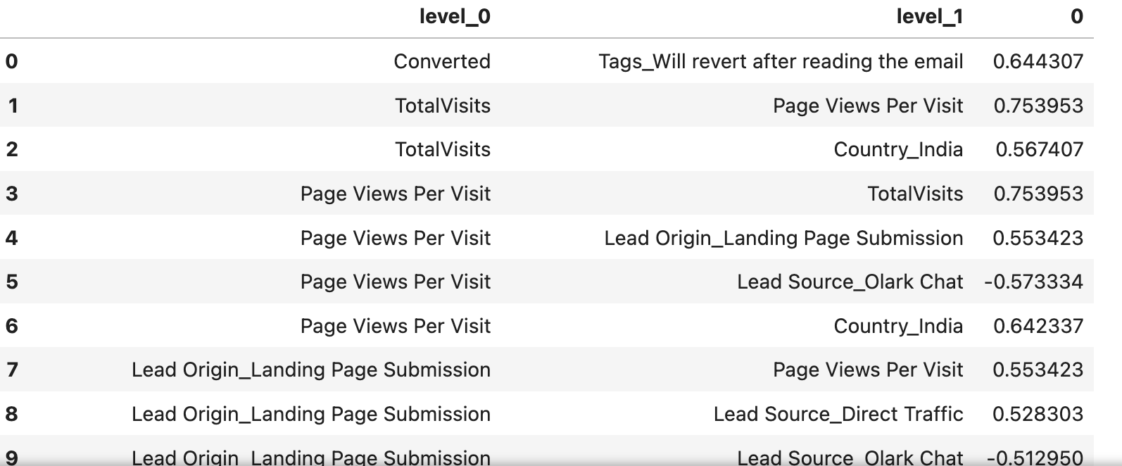
Feature Scaling and Correlation Analysis
After splitting the data into train and test datasets in the 80-20 ratio, we apply the transform to these datasets to know about the mean and standard deviation using feature scaling by normalization. This is to make each feature comparable to each other and see how they contribute to the model in the later stages.
We then looked at the correlation of all the variables to see if any variables had high correlations between each other in order to avoid multicollinearity. This was done using the correlation matrix, visual below denoting a part of the matrix where pairs of variables are listed along with their correlations. Therefore, whichever variables had high correlations and those which were unnecessary for the business were removed from the dataset.

Slide 7
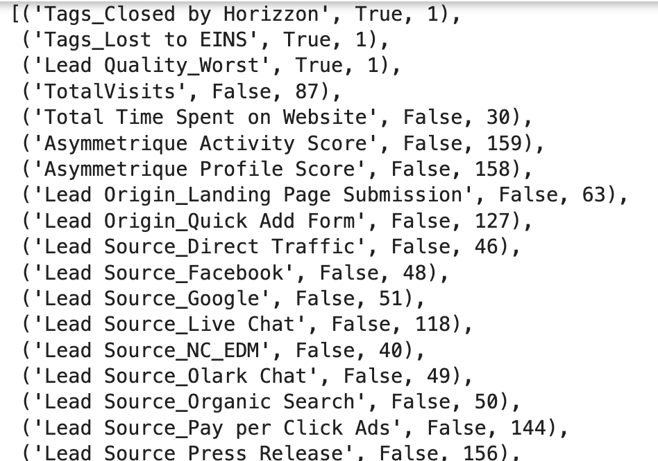
Logistic Regression Model Building and Early findings
Before building the model, we had to convert the columns with Boolean datatypes to 0 and 1 for the model requirements.
After building the model, the p-values of all the variables were 0 indicating all of them to be statistically significant so find the top 3 variables contributing most to lead conversion with reference to the subjective questions, we used Recursive Feature Elimination (RFE).Refer to the list of all the variables selected along with those top 3 being True and the rest being False down below.
After RFE, top 3 variables which contributing most to lead conversion were Tags_Closed by Horizzon,Tags_Lost to EINS,Lead Quality_Worst which were all categorical.

Slide 8
Strategic Recommendations for X_education
Therefore, by identifying the top 3 categorical variables influencing the lead conversion rate, the business should replicate successful strategies used by the Horizzon team across other campaigns. Therefore, X_education can train other teams to adopt similar approaches.
Moreover, for the variable Tags_Lost to EINS, they need to investigate why leads were lost to EINS and to strengthen competitive positioning such as pricing, course quality or customer service etc. Therefore, X_education should filter out low-quality leads over time especially for Lead Quality_Worst and then nurture these low-quality leads over time.

Slide 9
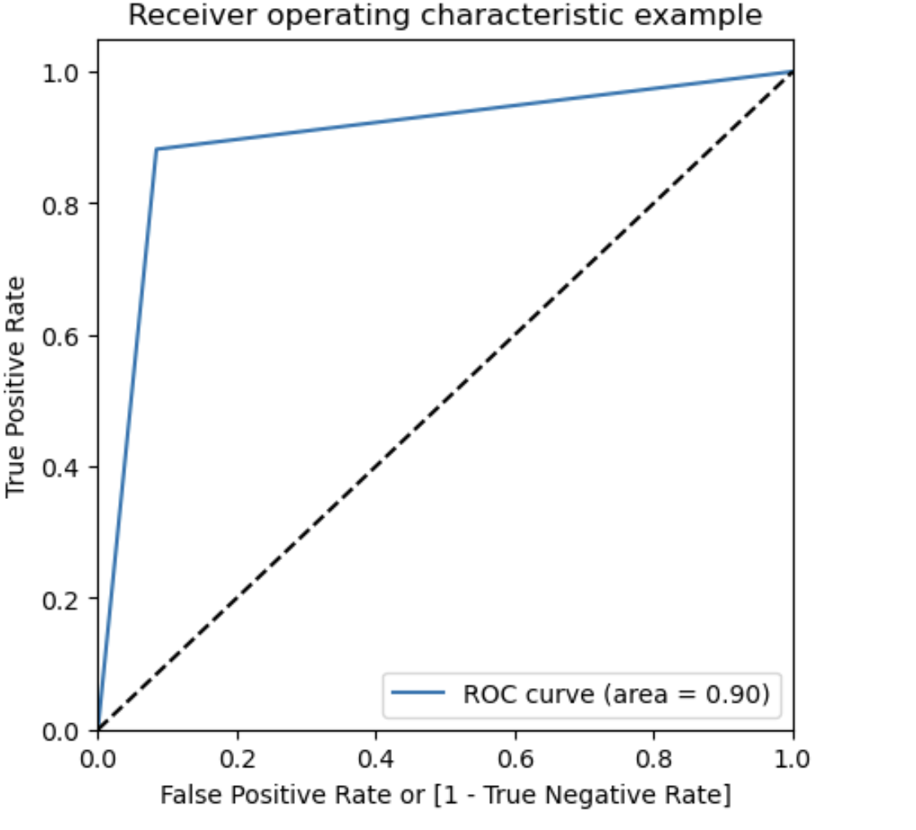
Model Evaluation on train dataset
After making predictions for the train dataset using the Logistic Regression model, confusion matrix was used wherein the accuracy score was approximately 90% accurate.
To further, check for any multicollinearity among the 3 selected features, the variables’ variance inflation factors (VIF) were checked. As all the VIFs were just around 1, there was no need to drop any variables.
Furthermore, to see if there were any misclassifications wherein some actual yes's for converted have been predicted as no's and vica versa, sensitivity, specificity, positive predictive value, negative predictive value etc. was calculated.
ROC curve was plotted and its findings indicated a relatively accurate test due to the area under curve being 0.9 along with curve follows the left-hand border closely, and then top border of ROC space. ROC is below:-

Slide 10
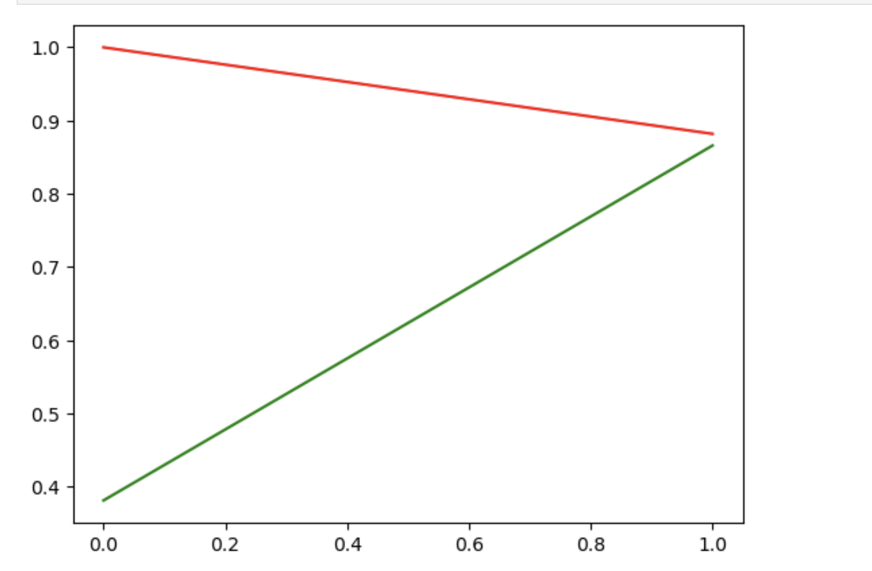
Model predictions and Evaluation on train dataset (Continued)
The optimal cut-off probability was found to be around 0.7977 using Youden’s Index which indicates a reasonable balance between sensitivity and specificity.
Furthermore, from the precision-recall tradeoff curve, precision and recall intersect at around 0.4-0.5 probability threshold indicating model is moderately good as this is where precision is at around 87% and recall at 89%. Precision-recall tradeoff curve below:-

Slide 11
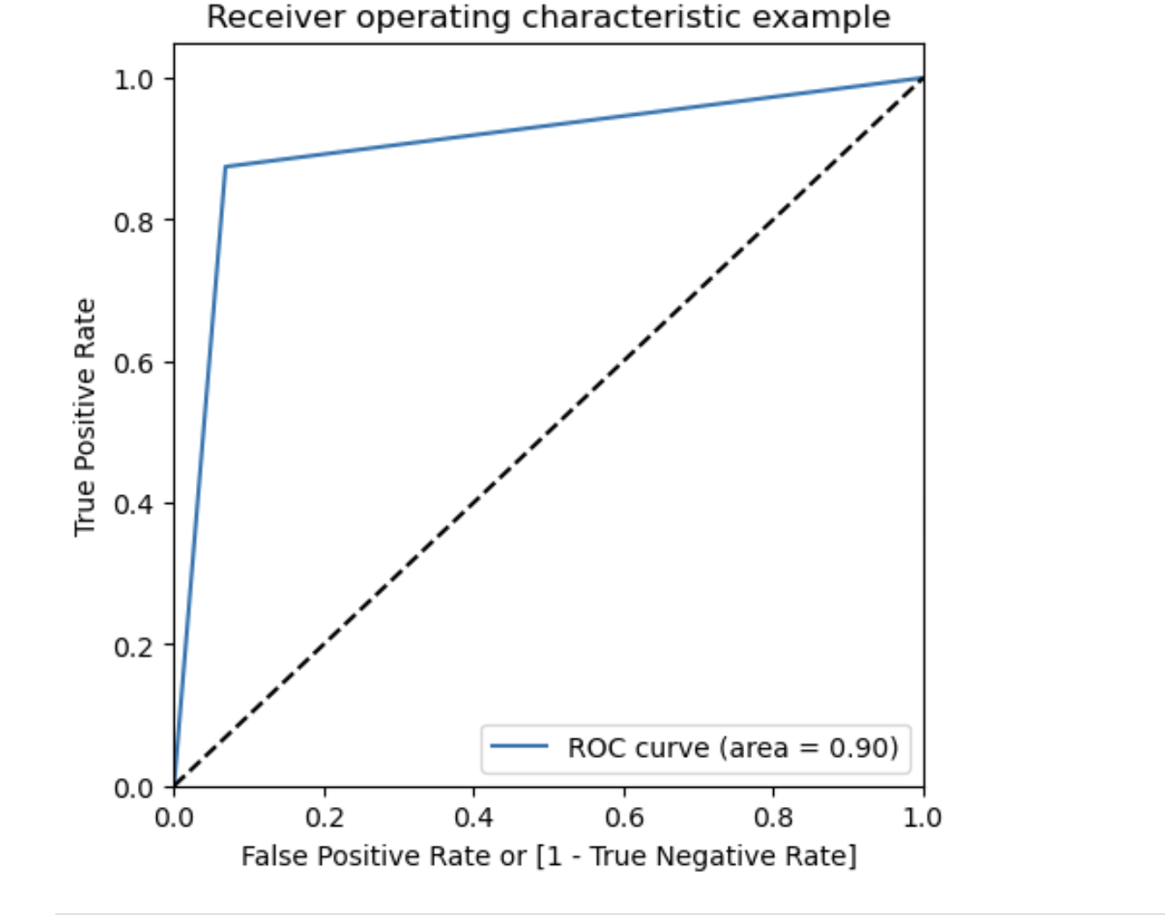
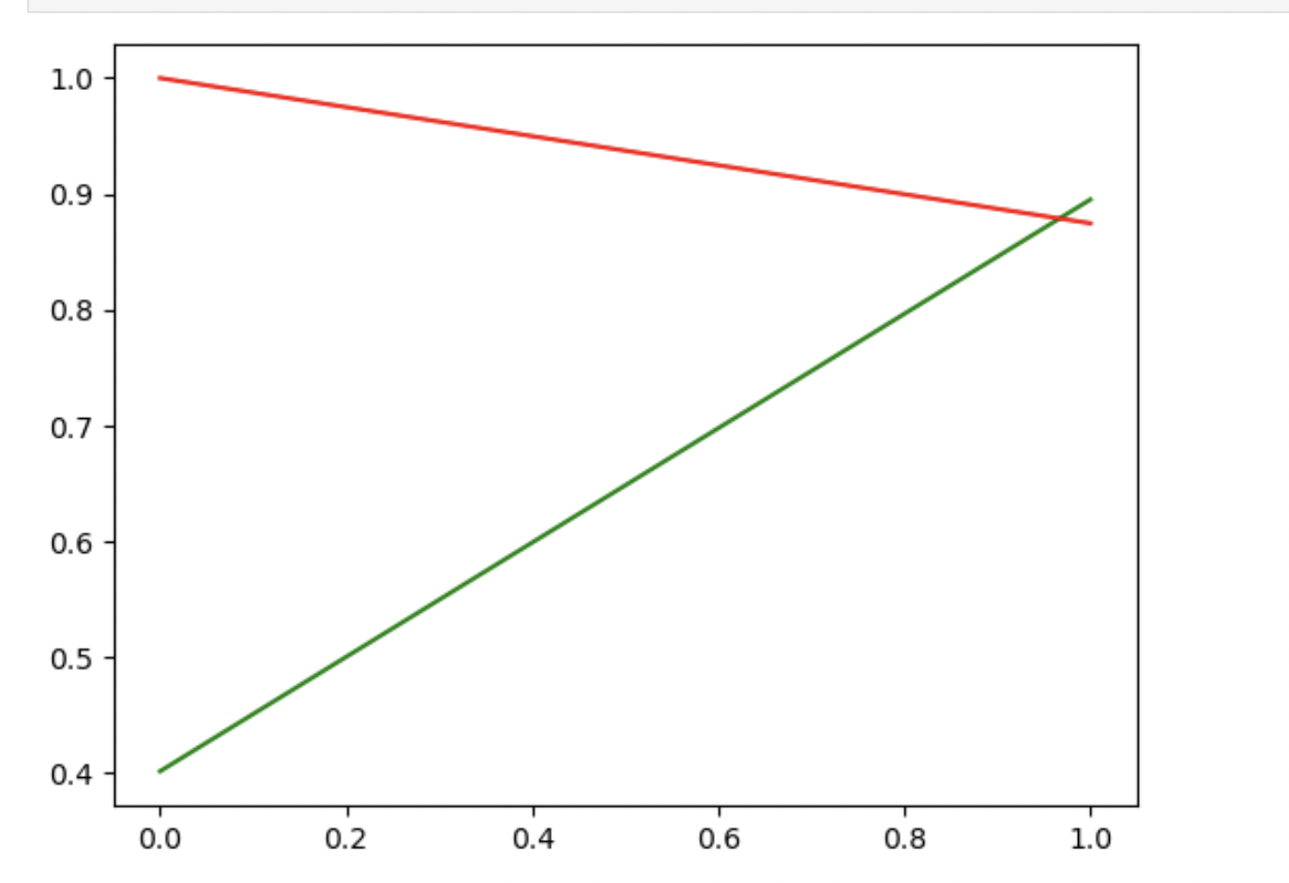
Making predictions and evaluations on test set
By making the predictions on the test set we have got specificity and sensitivity, precision-recall tradeoff very similar to the one on the train set and an accuracy slightly higher of 0.5% higher. Therefore, the optimal cut-off point obtained of 0.7977 was a good cut-off point applied on the test set. Therefore, intersection between precision and recall was around 0.4 to 0.5. ROC curve (left) and precison-recall tradeoff curve (right) for the test dataset is below:-

Slide 12
Overall business implications
Therefore, X_education should overall focus on leads tagged by ‘Close Horizzon’ and avoid wasting efforts on leads lost to EINS. Also, they should improve the quality early in the funnel by implementing the strategies.
Based on optimal cut-off of 0.7977, indicates the model will predict hot leads only when probability of lead is greater than 0.7977. Therefore, X_education should only use phone calls on these hot leads and for the rest, use automated channels such as SMS and emails.
The intersection of precision and recall is around 0.4-0.5 indicating a lower threshold in order for the company to capture more leads which maximizes recall but there could still be a lot of false positives.

Slide 13
Conclusion
Therefore, the logistic regression has successfully identified key variables influencing lead conversion and actionable strategies have been proposed to X_education for aggressive lead conversion and minimizing useless calls especially for lower-probability leads.
Henceforth, X_education can use these strategies in the real world to test them in order to test the model further to improve the accuracy of it beyond even 90%.

